Slide 1


Air Force Institute of Technology
NENG 791 – Proliferation of Weapons of Mass Destruction
Passive Detection of SNM
Lt Col Fee
E d u c a t i n g t h e W o r l d ’s B e s t M i l i t a r y
Notes:
This block of instruction provides an overview of the fundamentals and techniques for passive detection of SNM (and other radiological materials)
Some of these slides were taken from a slide deck developed jointly by the Massachusetts Institute of Technology, The Pennsylvania State University, and Texas A&M University with funding provided by the NNSA through the Global Threat Reduction Initiative. The purpose of this collaboration was to provide academic institutions with increased nuclear security-related education and training for integration in their nuclear science and engineering related programs.
There are two parts to the presentation, covered on two separate class days. (There is a slide to divide them.)

Slide 2
Passive radiation detection
How does the signature fall off with distance?
How does the geometric efficiency of the detector change with distance?
Notes:
The two primary signatures of concern are photons and neutrons.
To the left, you see a source, which emits photons and/or neutrons.
If the emitted particle is a photon, it is (at least when produced, though not necessarily when detected) monoenergetic and characteristic of the differences in energy levels within the nucleus (gamma ray) or atomic levels (characteristic x-rays)
The environment can have very little effect (e.g. almost no attenuation or down-scatter) or a significant effect (e.g. significant attenuation or scatter) on the particles.
The characteristics of your detectors and its placement relative to the source and environmental variables determines “what you see”
The detector has its intrinsic efficiency, which determines what fraction of each particle can be detected at a given energy
The geometric efficiency, related to both the detector size and distance, also impacts what fraction of the initial particles might be detected
The resolution of the detector (which is determined by the limiting step for information carriers) determines the ability to differentiate among particle energies.

Slide 3
Passive detection at a distance–general considerations
The signals are weak under the best of circumstances, the signal falls off as 1/r², but worsens with - Background interference - Shielding/intervening materials attenuate and alter the signal
In descending ease of detection: - (1) Fixed detector, stationary source (long count, constant bgd) - (2) Fixed detector, moving source (short count, constant bgd) - (3) Moving detector, moving source (long count, changing bgd) - (4) Moving detector, stationary source (short count, changing bgd)
Detection highly dependent on device design
Notes:
In general, under the best circumstances the signal (from the source) will fall off at 1/r² for any isotropically emitting source.
The inverse square effect is also compounded by absorption…actual sensitivity may be worse
The background, however, does not generally fall off at 1/r² since it is “spread” throughout the area.
Do you understand (and can you explain) why the four cases for detection are arranged in the specific order?

Slide 4
Passive detection of shielded nuclear materials: gammas
consider 10 kg of w.g. Pu, in the center of a 2-m tank truck of water
gamma emission rate is 3.3x10¹⁰ γ/s @ 414 keV
but γ self-attenuation is 1/300
and solid angle is 1/4π·100²=1/125,000 cm²
and γ absorption in water is 1/33,000
so signal is 0.02 γ/cm²s
~ cosmic-ray muon rate
²³⁵U is 20 times more difficult to detect!
Notes:
This is a simple example of shielding putting material in center of a 2 m diameter tank of water, similar to tanker trucks.
In the Signatures of Special Nuclear Materials block, we looked at the difficulty in detecting neutrons (it’s reproduced in the hidden slide that follows)
Now we consider looking at the gammas.
The signal is about equal to the cosmic-ray muon rate, which we know varies with time (and other factors)

Slide 5
Passive detection of shielded nuclear materials: neutrons
consider 10 kg of w.g. Pu, in the center of a 2-m tank truck of water
spontaneous neutron emission rate is 520,000 n/s
99.98% from ^{238,240,242}Pu impurities
but self-shielding (@1 MeV) is 1/1.3
and thermalization × absorption × Ω is 1/1x10⁸
so signal is 0.004 thermal n/cm²s
About 1/5 of cosmic-ray neutron rate
²³⁵U is 10⁶ times more difficult to detect!
Notes:
Weapon grade definition from Nuclear Threat Initiative (NTI.org). 0.01% 238, 93.8% 239, 5.8% 240, 0.13%241, 0.02%242, 0.22% Am-241. Calculation by Lindstrom at NIST using 2-group calculation from J. R. Lamarsh, Introduction to Nuclear Engineering, 2nd ed., Addison-Wesley, Reading, MA, 1983.
Note that cosmic ray induced neutrons are especially present with eg large steel structures (the “Ship Effect”)

Slide 6
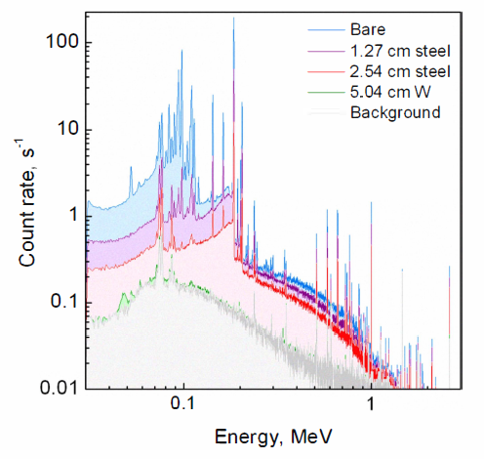
Passive detection of shielded nuclear materials: gammas
Notes:
This shows a high resolution gamma spectrum of a large (~10kg) piece of HEU behind various amounts of shielding.
Note that 5 cm of W essentially reduces the signal to background levels [Chichester et al 2011 IEEE NSS-MIC conference record]
Of course, if you want to detect the HEU gamma signature, you need (depending on your confidence level) significantly more (possibly a standard deviation or more) than the background rate.

Slide 7
Signal to noise
No background, limited by statistics
Known and measureable fixed background
Unknown and variable background not limited by statistics is independent of the size of detector
Are there conditions where there is no background?
Notes:
What determines the resolution of your detector?
The step with the minimum number of information carriers.
Are there conditions where there is no background?
If you are looking only at passive detection, no.
If you are looking at active detection, it may be possible to produce a signal that is not normally found in nature (but this seems to be quite difficult).

Slide 8
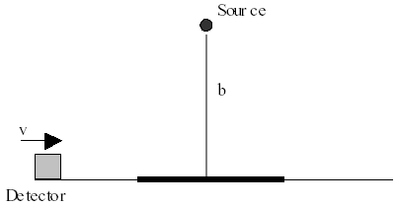
Passive detection at a distance: is bigger better?
Could the assumption of a constant and known background be true for a moving detector?
What about for a stationary detector?
For constant and known background, the answer is yes!
Notes:
You may find yourself answering the question, “which detector should we use?”
The answer depends.
If you have a constant and known background a bigger detector is better.
For a “moving” detector, the background is certainly not constant and not known.
For a “stationary” detector, you have a much better characterization of the “constant and known background.” Of course, “constant and known background” is a pretty big assumption.

Slide 9
The unknown background case
Statistics are not the determinant in this case.
The answer is that bigger is not better!
Notes:
For an unknown background, the “bigger is better” answer to the detector question is not true.

Slide 10
Omnidirectional detectors have a problem (1)
Simple physics allows us to calculate the counts vs time seen by an omnidirectional detector as one tracks past a source of known strength and distance.
To acknowledge the real world: include a region that doubles the background
r
b
V
x
Notes:
Since the detector is “omnidirectional” it picks up background from 4 pi.
This is a more “insight” kind of example rather than a rigorous.
We know that the background can change so, for this particular scenario, we have a source emitting particles in all directions that is located near the background.
You would expect that, as you approach and enter the higher background region, the number of counts (not considering those from the source will increase).
This should be observed as a “hump” in your count rate.

Slide 11
Omnidirectional detectors have a problem (2)
Simulated results for a 10,000 cm² omnidirectional detector
10 m
15 m
20 m
Even for 10,000 cm² area detector, the source is gone at 20 m.
A larger omnidirectional detector is not better!
Notes:
And, as expected, we get the “hump” in the count rate.
The peak (from the source) is present at 10 m, is slightly apparent above background at 15 m, and disappears by the time you are at 20 meters (detector to source distance).

Slide 12
Imaging solves our problem
Imaging returns distributed strength to one pixel
Imaging provides sensitivity by measuring local background
Sensitivity increase over conventional system is more than one order of magnitude for a large detector
100 cm² det at 20 m
100 cm² det at 50 m
10,000 cm² det at 50 m
SOURCE
An imaging system differentiates sources of large extent from the physically small sources of interest, so that a larger detector is better.
Notes:
I should note that “imaging” does not always solve the problem.
The concept of imaging is basically that you want to “create a picture” of the radiation field.
For this, each detector represents a pixel.
You can use “masking” which preferentially allows particles to pass through different directions into your detector.
There are many ways to do this.
For a small (point) source, you may be able to use a “mask” to pinpoint where the source is located.
For a larger (distributed) source, you determine the region where the source is located.

Slide 13
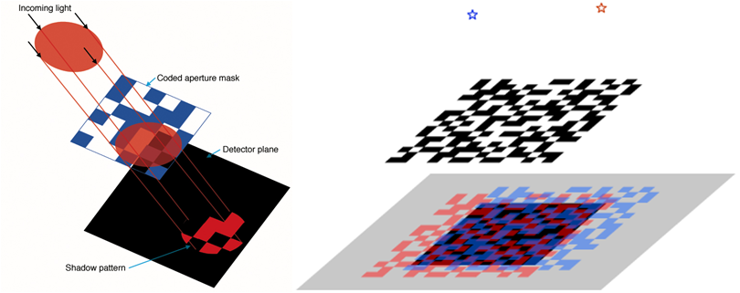
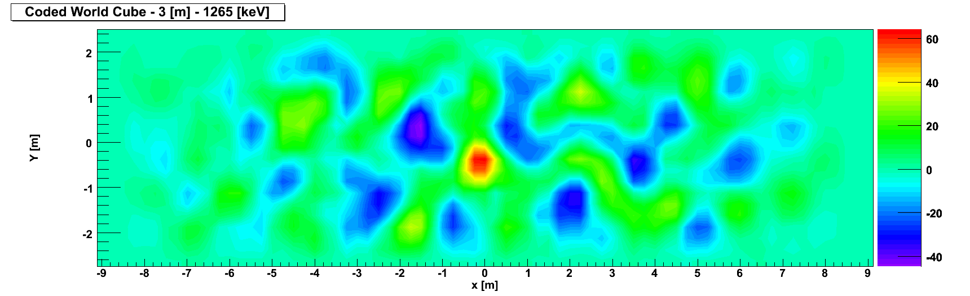
Coded aperture imaging can be used effectively for imaging of gamma-rays
How does the gamma energy (and the choice of “mask” material) impact your ability to image higher energy photons?
Notes:
Here is an example, using a “coded aperture.”
While this shows “light” we know that light, like photons, are just EM waves.
The higher energy gammas are not attenuated as easily so the higher transmission through mask can make the method less effective.

Slide 14
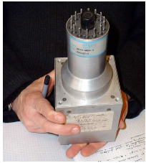
Coded aperture for remote detection of fissile materials
This is a coded aperture array able to image small sources at distances of up to 100 m while driving by at 25 mph
Imaging separates signal from background for improved SNR
Notes:
Shown here is a large NaI(Tl) array constructed by LLNL and MIT with 1 D coded aperture.

Slide 15
Background removal in coded aperture imaging
contribution to background by sources outside of the detector field of view
removal by the use of a mask-antimask combination
Notes:
Note the mask and antimask configuration here (the “holes” of one are the “barriers” of the other and vice versa.
How in the world does this work?
(1) Some of the background will pass through the mask and antimask but the amount is greatly reduced.
(2) The point (or distributed source) is continually emitting gammas in 4pi so they are continually impinging on the mask-antimask configuration
(3) At any point where the incident particle passes through both the mask and anti-mask, a pixel will register a count.
(4) You can use the temporal information with the counts (and some algorithms) to determine where the particle came from and construct your image.
Credit: LLNL

Slide 16
Coded aperture imaging of warheads
Notes:
(a) The gamma ray imaging spectrometer (GRIS) takes pictures of the high-energy gamma radiation given off by the nuclear materials
The images are encoded on the detector by using a coded aperture mask that allows the user to recover the image through a computer algorithm.
(b) One potential application of the GRIS is for nonintrusive treaty inspections.
(c) The image of a multiple warhead missile taken with the GRIS clearly shows each of the warheads.
Credit: LLNL

Slide 17
RHESSI imager (NASA)
Notes:
NASA does the same sort of thing for looking at radiation coming from the sun (or the cosmos)

